Slide 1

ONLINE E-Banking TESTING
Course Code:CSA371
Course Name : Software Testing
Date:31/1/23
Name:- GIRI .K.B
Reg no:-192021015

Slide 2
OBJECTIVES
To enable bank customers to use mobile instruments as a channel for accessing their banks accounts and remit funds.
Use of computers and telecommunications to enable banking transactions.

Slide 3
ABSTRACT
Banking institutions are facing competition not only from each other but also from non-bank financial intermediaries as well as from alternative sources of financing..
Consumers are becoming increasingly discerning and have become more involved in their financial decisions. For many consumers, electronic banking means 24-hour access to cash through an automated teller machine (ATM) or Direct Deposit of pay checks into checking or savings accounts.

Slide 4
PROPOSED SYSTEM
Installing Android Studio and APPIUM applications.
Setting up an Emulator in Android Studio with latest version.
Login
Password
Net Banking
Saving Bank A/C
Customer care

Slide 5
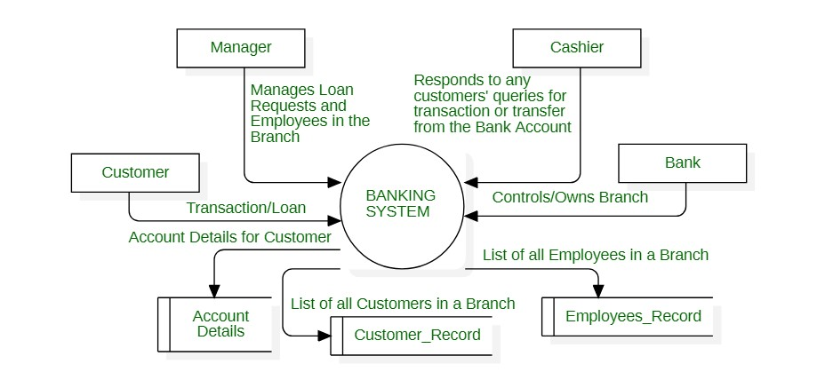
FLOWCHART

Slide 6
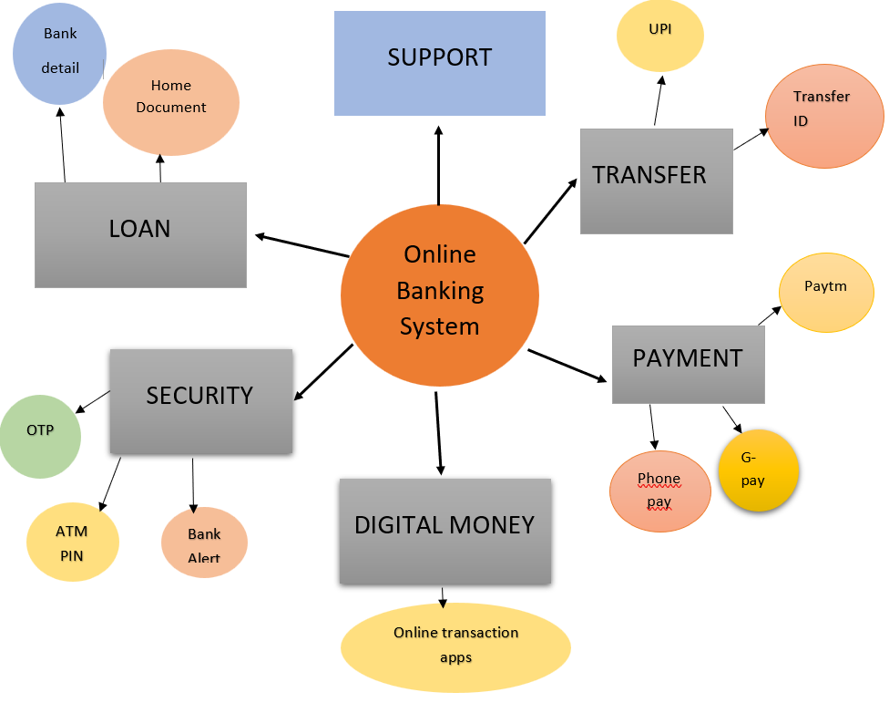

CONCEPT MAP

Slide 7


APP TOOLS AND INSTALLATION
Android studio
Appium Inspector
Appium Server
Lamdatest

Slide 8
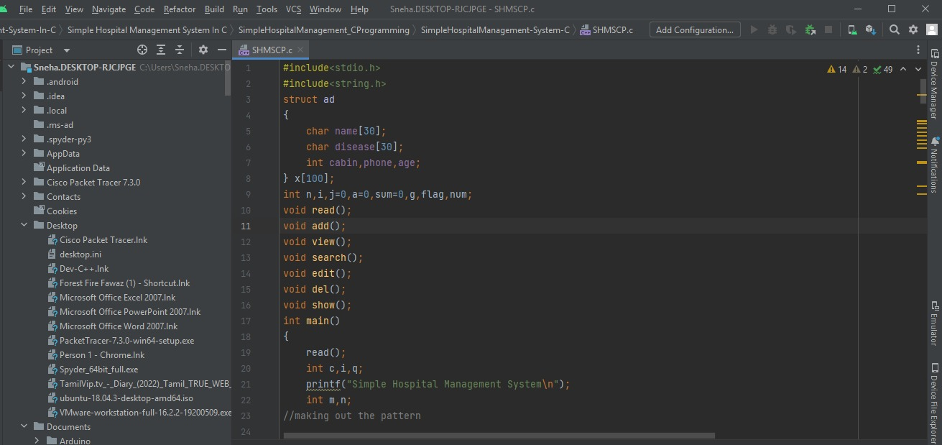
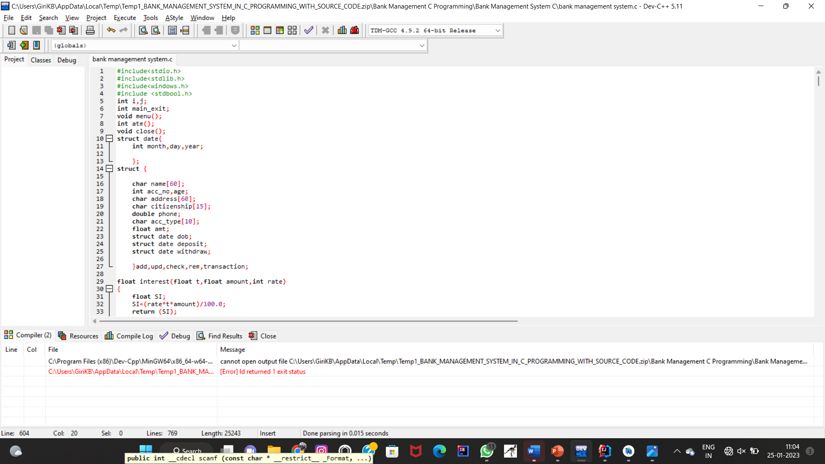
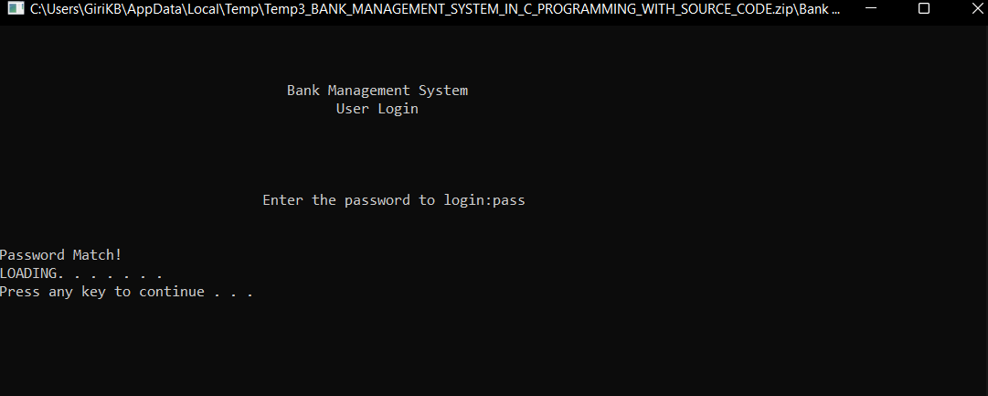
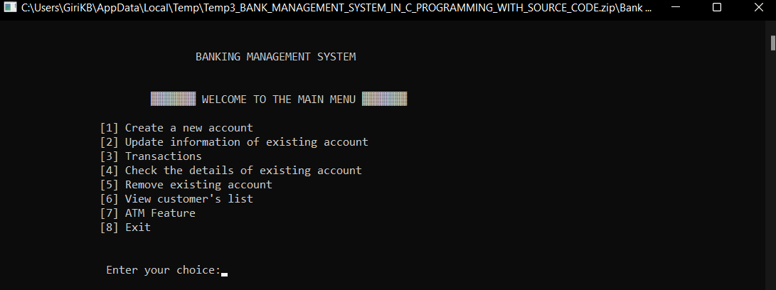
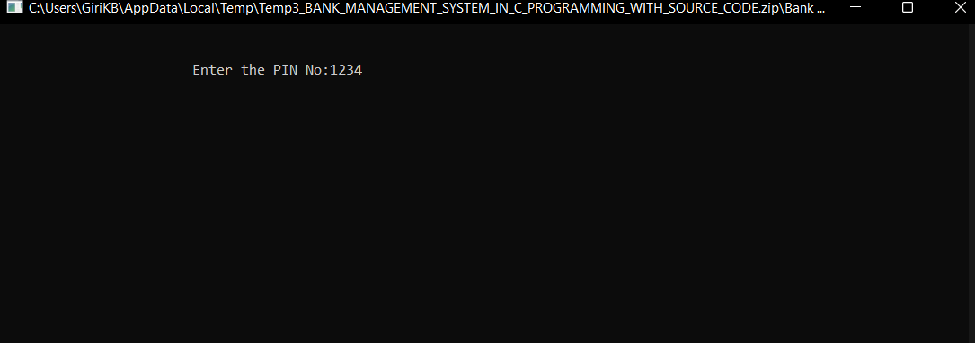
IMPLEMENTATION

Slide 9
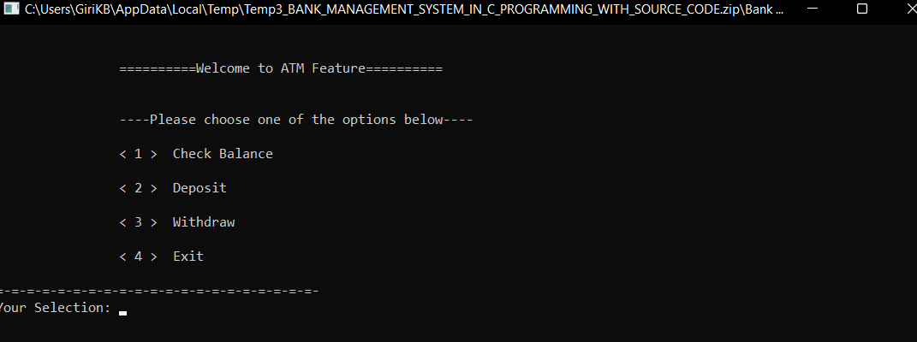
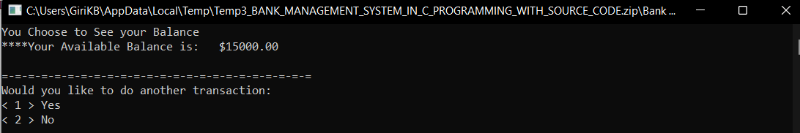
IMPLEMENTATION

Slide 10
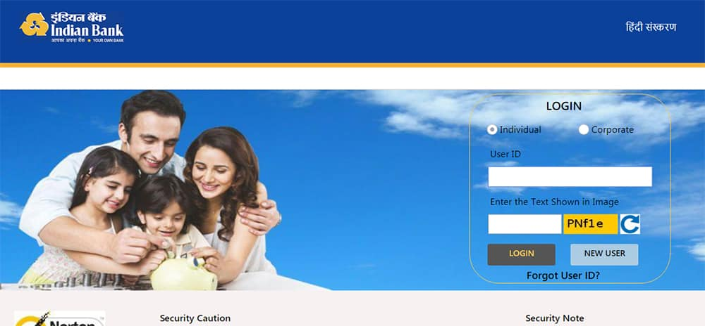
LOGIN INTERFACE OF INDIAN BANK

Slide 11
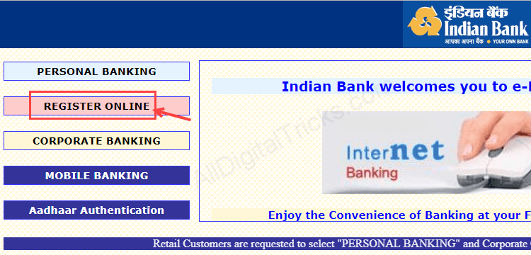
REGISTRATION PROCESS

Slide 12
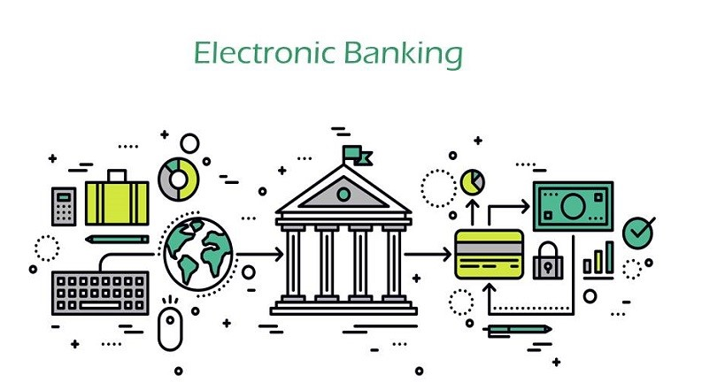
IMPORTANT LAYERS OF E-BANKING
1. Admin interface :- for managing the application
2. user interface :- Conducting business operations
3. database :- to communicate with banking database

Slide 13
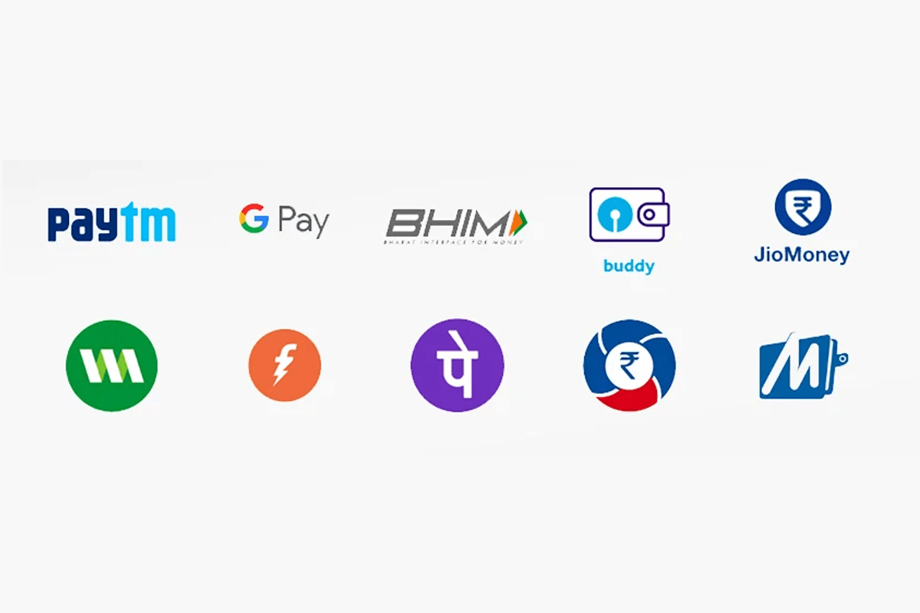
UPI APPLICATIONS

Slide 14
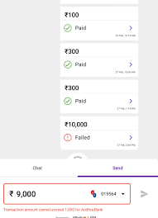

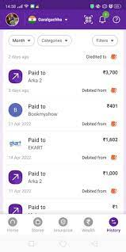

Slide 15
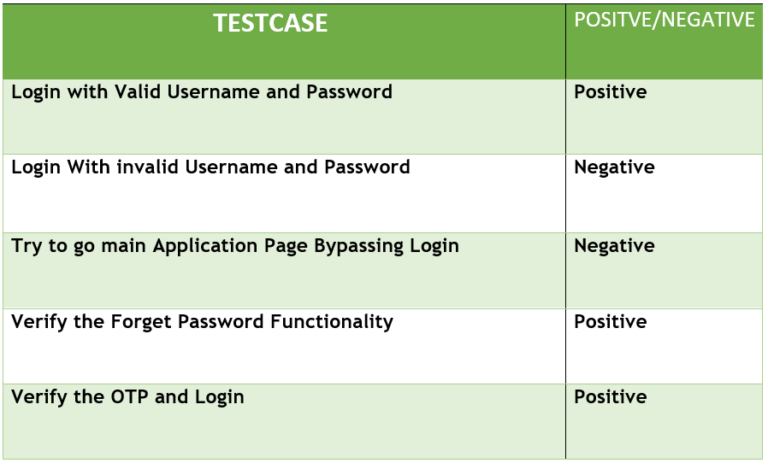
TESTCASES

Slide 16
CONCLUSION
E-banking offers a higher level of convenience for managing one's finances. However, it continues to present challenges to financial security and personal privacy. Many people have had their account details compromised, as a result of online banking. Thus, if one is going to use it for financial transactions, he should be aware of the risks involved. Awareness of the risks and problems enables him to take precautions for a more secure online banking experience.

